Slide 1
senior meeting 24 aug

Slide 2
Before rework

Slide 3
After rework

Slide 4
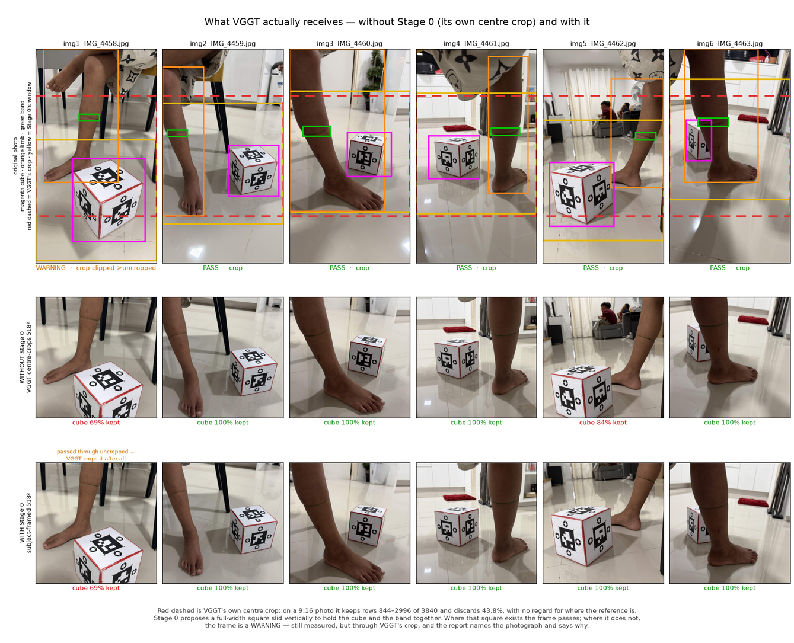
After rework
stage 0 prep data

Slide 5
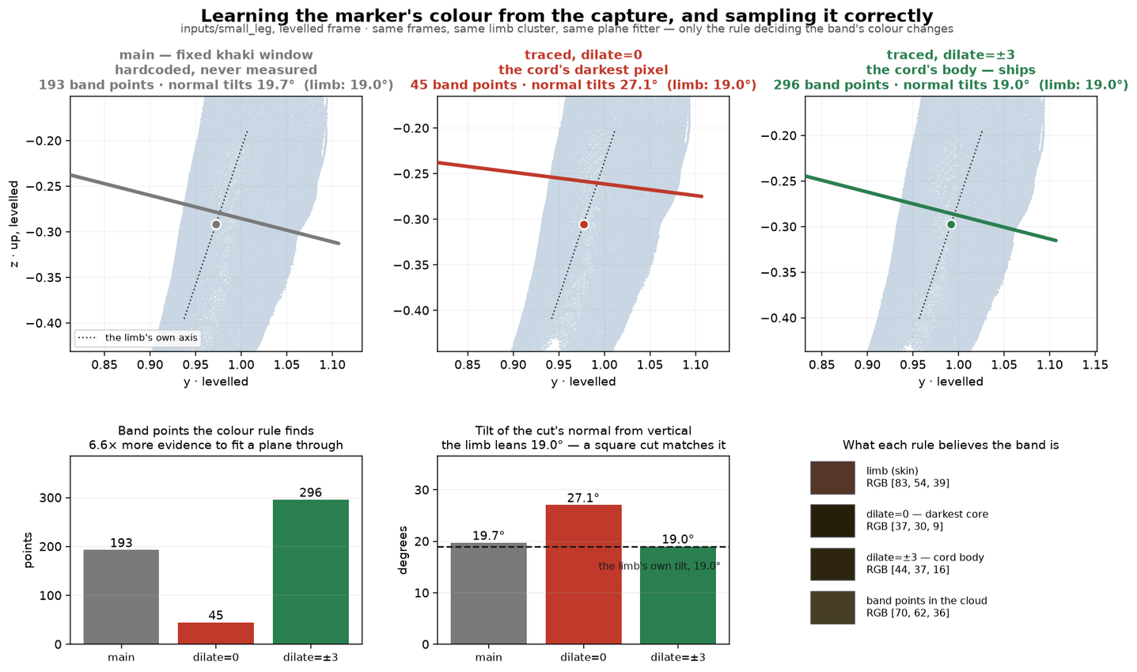
After rework
stage 3 clean ply

Slide 6
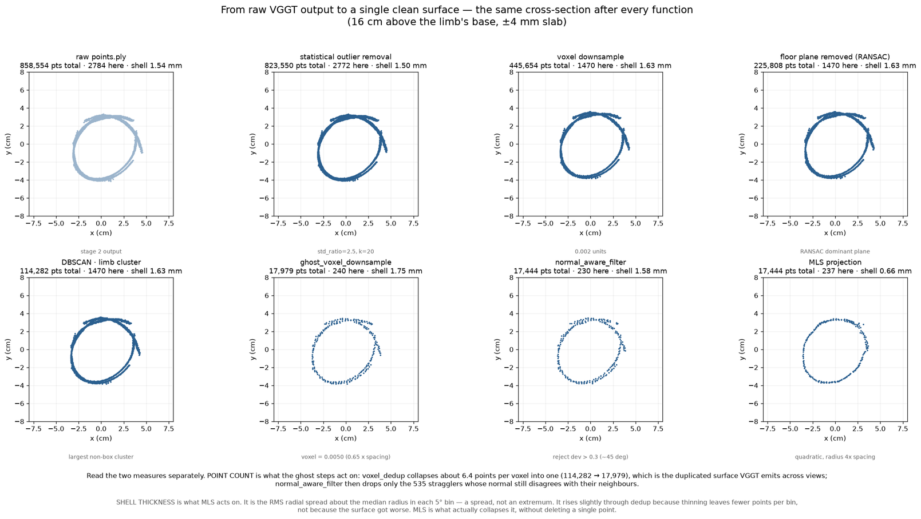
After rework
stage 3 clean ply

Slide 7
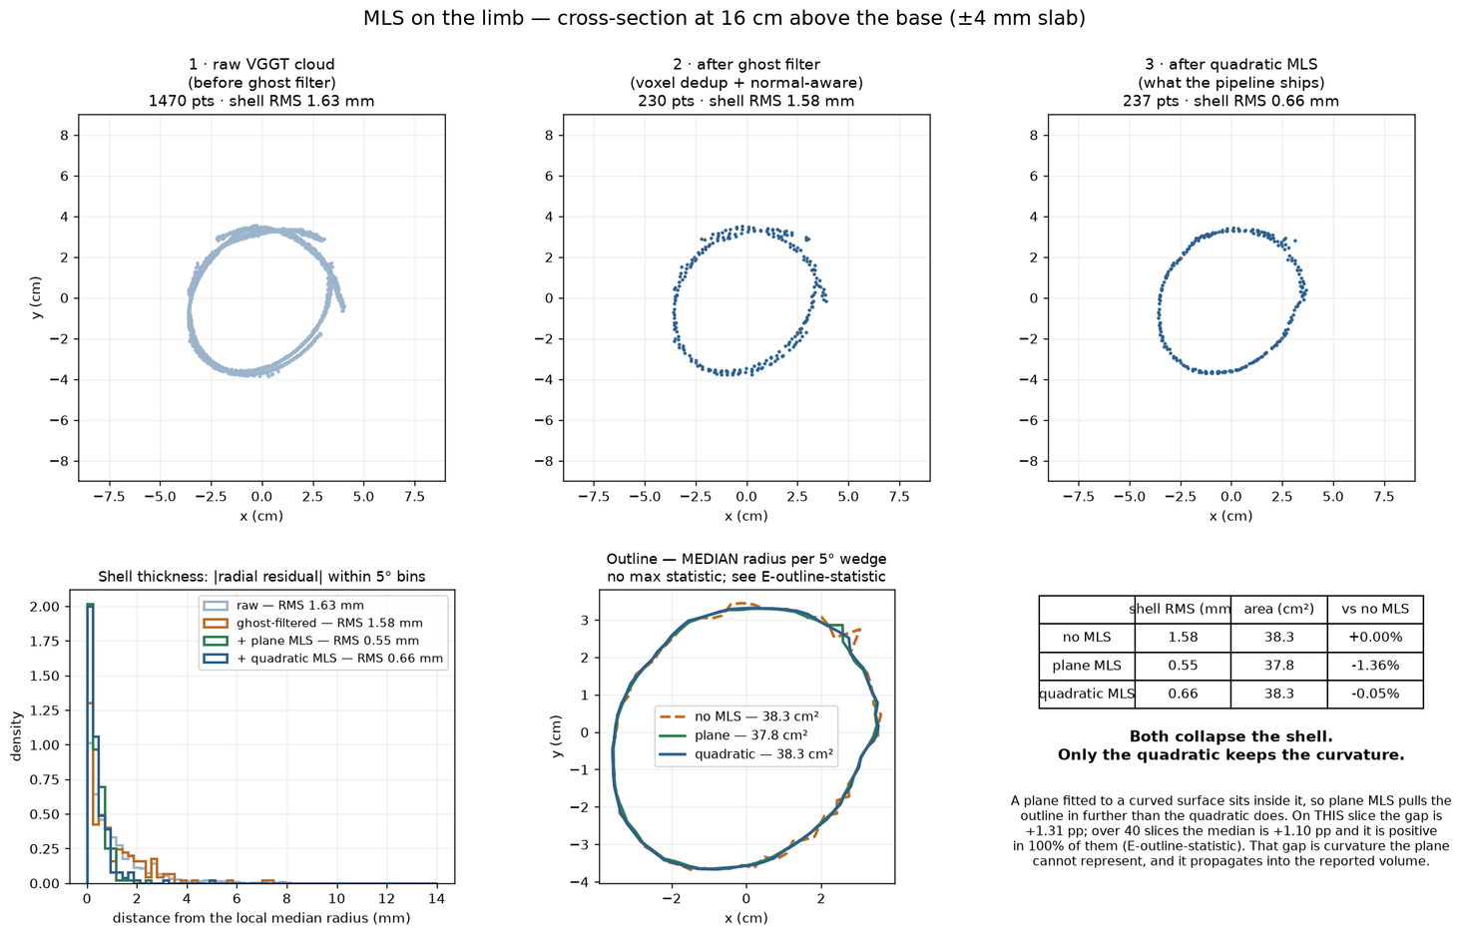
After rework
stage 3 clean ply

Slide 8
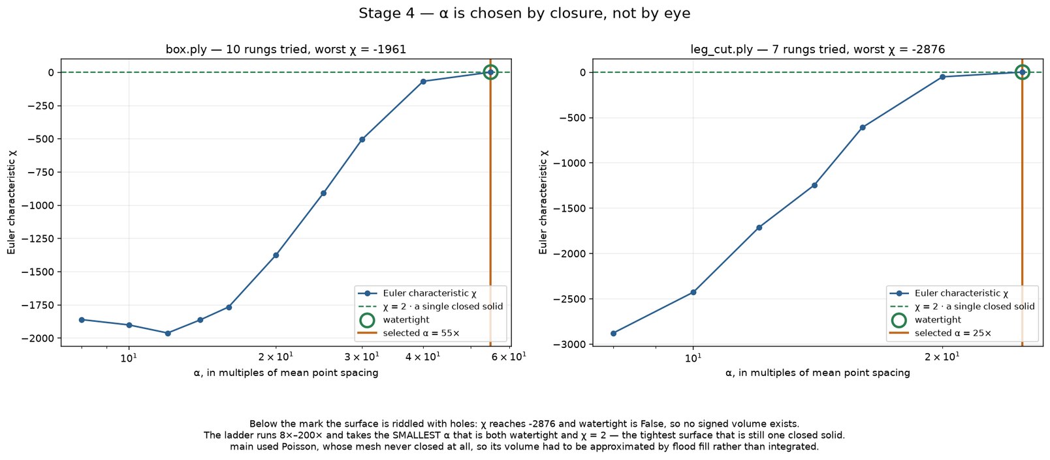
After rework
stage 4 recon

Slide 9
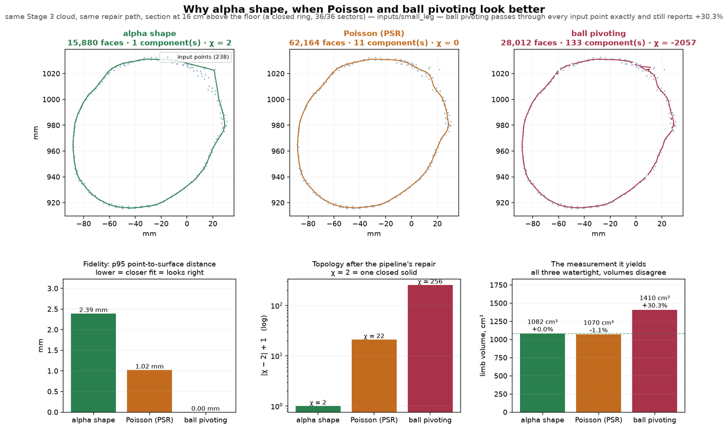
After rework
stage 4 recon

